Slide 1
Postgraduate Literacies & Research Skills Workshops
Workshop 6: Research structures and technicalities
Presented by :
Tapiwa Gundu (PhD)

Slide 2
How to conceptualise ideas
Brainstorm
Think aloud
Don’t criticize
Appreciate the uncommon
Combine and improve
Make a list
Put them on the wall
Use a deck of index cards
Mind mapping

Slide 3
Turning your ideas into structured writing
Once you have refined your ideas, you need start thinking about:
What needs to be researched?
What would be the benefits?
What goals would you set for your self?
What would potentially prevent you from reaching those goals?
From here you would want to focus primarily on fitting this research ideas into a formal research structure.

Slide 4
Research Structure
Presenting a well-structured dissertation is going to make your dissertation/ thesis a pleasure to read and is a sure way of gaining you marks.
Meeting the Main Parts of Your Dissertation/Thesis
Most dissertations follow the same basic structure and are made up of six parts:
an abstract,
introduction,
methods and discussion,
conclusions and
references.
Although the exact detail of each part can vary (such as the numbers of words allowed in the abstract), the inclusion of each part is standard and fixed.

Slide 5
Abstract
The content of your abstract is important because what you say in your abstract gives the readers the opportunity of judging whether your dissertation is going to be of interest to them.
Your abstract is an overview of your whole study:
a summary of your research question,
methods and results – so you can’t write your abstract until you’ve pretty much finished your research.
When you come to the stage of writing your abstract, it’s likely that you’re feeling pretty stressed, trying to tie up all the loose ends of your research after having dedicated years to your project.
You can imagine how tempting it can be to scribble a short piece as quickly as possible but you can also see that such an approach isn’t going to do you any favours or win you marks.

Slide 6
Introduction
With your introduction you’re preparing the ground for the main body of your dissertation/thesis. In your introduction you’re looking to inspire an interest in your work and explaining something about the background and your reasons for choosing your research topic.
Aim to give the reader a clear idea of what to expect to find in the main themes you’re presenting and the methods you’re using, saying if you’ve done something experimental and practical, or taken a more theoretical approach.
You can hint at the findings and conclusions, but you needn’t spell them out as in the abstract. To wet the reader’s appetite, try to raise their curiosity as to how the dissertation is going to end.
The introduction is a good place to explain your rationale for the choices you’ve made. Perhaps say what motivated you to pick this research question

Slide 7
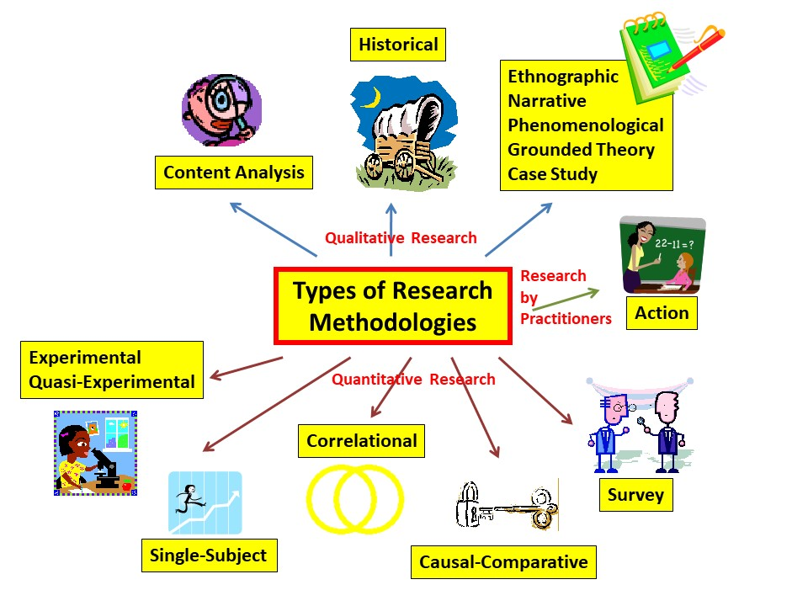
Methods and discussion
When you reach the main movements of your dissertation – your methods and discussion – you now take an empirical or a nonempirical route. The elements required in empirical and non-empirical dissertations are subtly different.

Slide 8
Conclusion
Every dissertation must have a conclusion – otherwise your research can end up being a pointless interpretation and merely a review of vaguely related ideas.
A successful dissertation conclusion is short and succinct. Restate the aims of your work and show how your original thoughts have been reinforced or changed through your well-planned and carefully executed research, whether your research is theoretical or practical. You then make a few suggestions on how you can improve or extend your work if you have the opportunity.

Slide 9
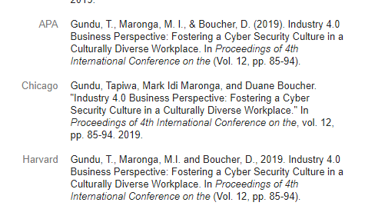
References
You need to understand and follow the rules governing references in your field of study and your university when you’re presenting your research, even though the system of referencing seems fiddly and fussy.
Note: formatting and checking your references will 99% certainly take you far longer than you expect.

Slide 10
Dynamic Table of contents
Whenever you write a long document, in this case a thesis or dissertation, you’ll need to include a table of contents. If you like doing things the slow way, you could type this out manually and painstakingly modify it every time you make a slight change to a subheading.
However, there’s an easier way: Use Microsoft Word’s “Style” options to create a table of contents that can be updated at the click of a button!
For more details on how to create dynamic table of contents in work, please follow the link below:
https://shaunakelly.com/word/numbering/tableofcontents.html

